Slide 1
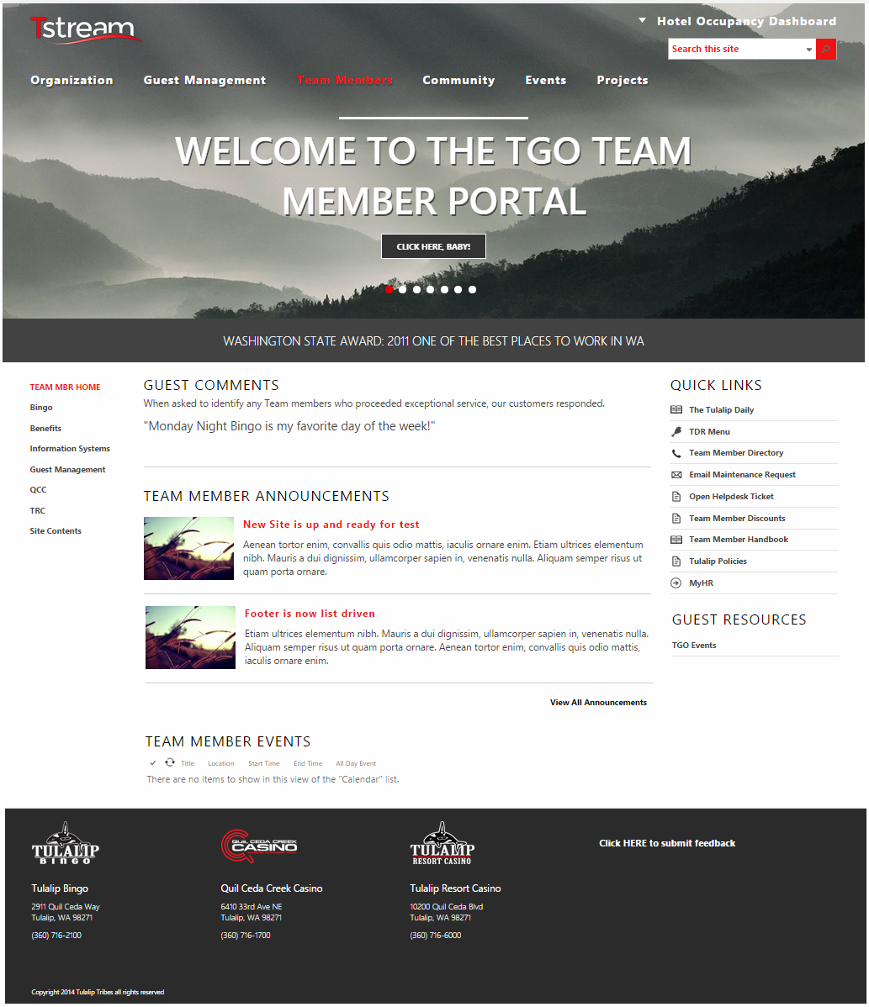
Tulalip Resort Casino SharePoint Site
The Challenge
Tulalip came to Affirma with an issue of not having a central location to store widespread information throughout the company. They had a previous vendor that they were using for SharePoint development but quickly found they were not getting the value they needed.
What We Did
Affirma stepped in with a strong BA team to understand Tulalip&rsquo;s core issues. We came up with a solution to create a SharePoint site that contained two distinct areas: one for managing Tulalip guests, and another for managing internal Tulalip employee content. In addition, creating a &ldquo;Guest Management&rdquo; section within their SharePoint site would strive to bring together all the different knowledge streams.
Results
Affirma's approach helped to centralize all the different information that Tulalip employees use for giving their guests the best service since there are so many different departments that handle guests and contain specific information.

